Slide 1


An analysis of procrastination and various related factors among students

Slide 2

Group Members
Abdullah Ghalib
Kaneez Fatima
Zohha Azhar
Ammar Siddique

Slide 3



Our Objective
Factors Analysis:
Investigating diverse factors contributing to student procrastination..
Variation Identification:
Pinpointing key variations in procrastination triggers and behaviors.
Student-Centric Insights:
Understanding procrastination from the perspective of individual student experiences.
Actionable Recommendations
Providing recommendations for educators and students to effectively address procrastination challenges.

Slide 4


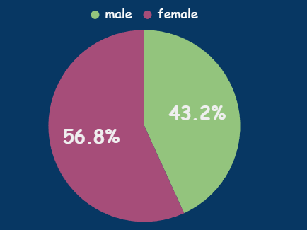
Sample Size
213
121
92

Slide 5
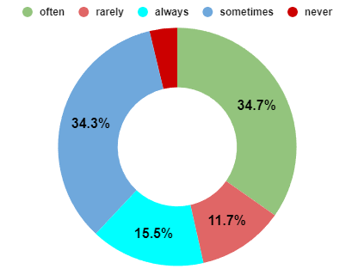
Do you procrastinate?
Demographics
Confidence Interval = 95%

Slide 6
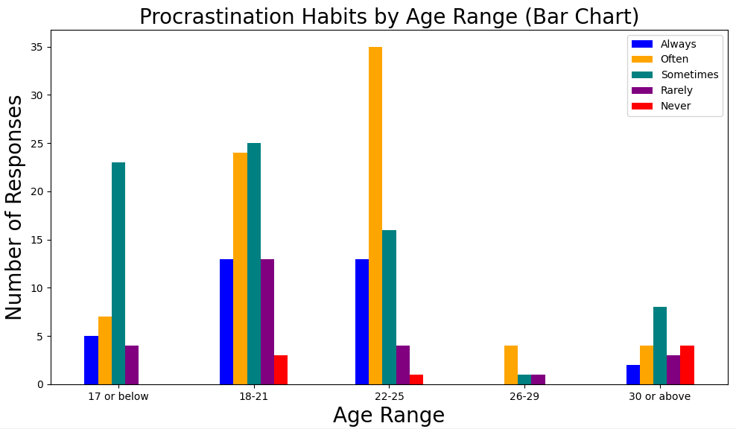
Age
Which age group of people tends to procrastinate more or less?
Confidence Interval = 95%

Slide 7
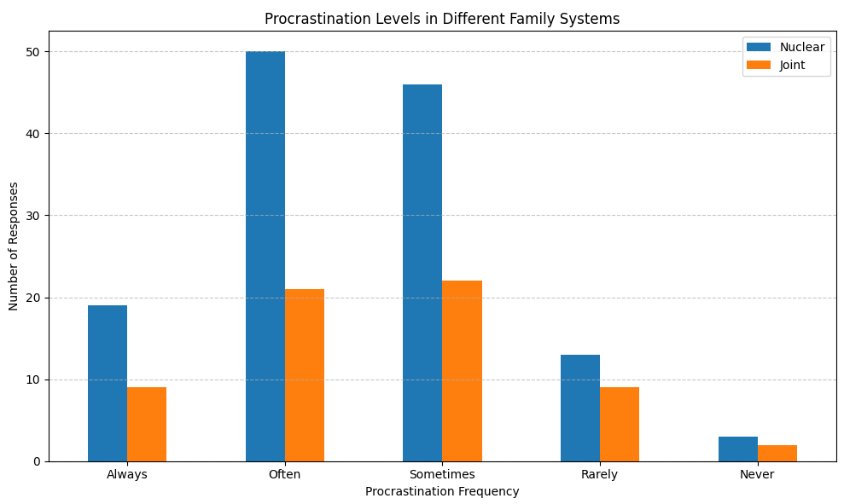
Family System
Levels of procrastination in different family systems
Confidence Interval = 95%

Slide 8
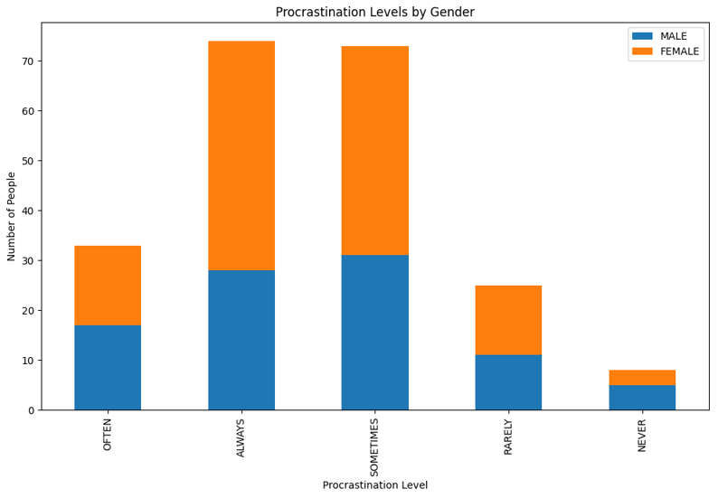
Gender
How different genders procrastinate?
Confidence Interval = 95%

Slide 9

Do you have a clear goal in your life or not ?
Lets assume, 50% people have clear goal in their life.
Hypothesis
NO.1
H₀ : P = 0. 5
H₁ : P ≠ 0.5
p̂ = $\frac{147}{213}$ = $\frac{p}{n}$
α = 0.05
Z_{cal} = 5.550 (After calculation)
Z_{α/2} = 1.96
Z_{cal} > Z _{α/2} (True)
Inference: This shows that the hypothesis was incorrect, we will reject the NULL hypothesis.

Slide 10
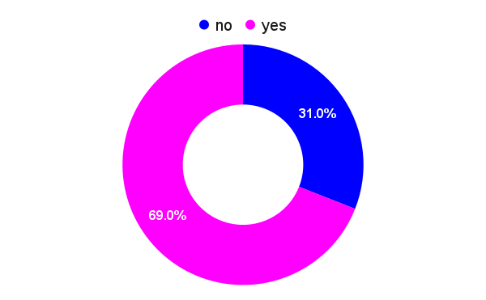
Hypothesis NO.1 (Cont.)

Slide 11

Hypothesis NO.2
How frequently do you consider making a timetable for your task?
We are claiming that 70 % people usually consider making of timetable (Taking “OFTEN” as success).
p̂ =portion of students that makes time table
H₀ : P = 0. 7
H₁ : P < 0.7 (one tailed test)
p̂ = $\frac{57}{213}$ = $\frac{number of people who marked often}{sample size }$
α = 0.05 (significance level)
Z = 0.95 (confidence level)
Z_{cal} = -13.77( After calculation)
Z_{α} = -1.645 (one tailed)
Z _{cal} < Z_{α} (True)
Inference: This shows that H₀ was incorrect, we will reject NULL hypothesis.

Slide 12
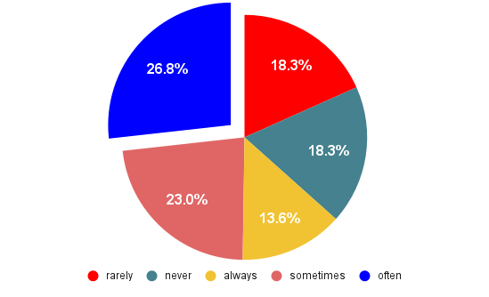
Hypothesis NO. 2
(Cont.)

Slide 13

Hypothesis NO. 3
Are you able to complete your tasks according to the timetable you make?
We are claiming that 40% people complete their tasks according to the timetable they make. (Taking “OFTEN” as success).
p̂ = portion of students that complete tasks in time
H₀ : P = 0. 4
H₁ : P < 0.4 (one tailed test)
p̂ = $\frac{46}{213}$ = $\frac{number of people who marked often}{sample size }$
α = 0.05 (significance level)
Z = 0.95 (confidence level)
Z_{cal} = -5.48( After calculation)
Z_{α} = -1.645 (one tailed)
Z_{cal} < Z_{α} (True)
Inference: This shows that Null hypothesis was wrong an we reject H_{o}.

Slide 14
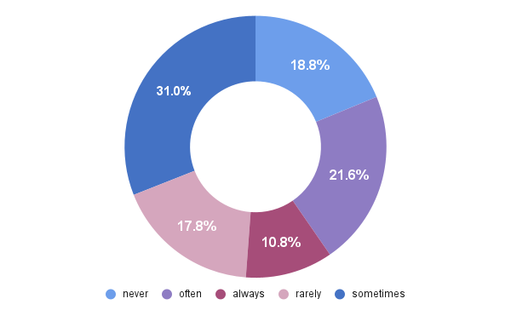
Hypothesis NO. 3 (Cont.)

Slide 15

Hypothesis NO.4
Do you use social media for recreational purposes ?
The claim is 70% people use social media for recreational purpose. (Taking “OFTEN” as success).
p̂ = portion of students that complete tasks in time
H₀ : P = 0. 7
H₁ : P > 0.7 (one tailed test)
p̂ = $\frac{79}{213}$ = $\frac{number of people who marked often}{sample size }$
α = 0.05 (significance level)
Z = 0.95 (confidence level)
Z_{cal} = 1.045( After calculation)
Z_{α} = 1.645 (one tailed)
Z_{cal} < Z_{α} (False)
Inference: The Null hypothesis was right and we fail to reject H_{o}.

Slide 16
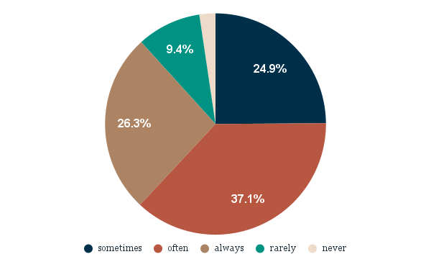
Hypothesis NO. 4
(Cont.)

Slide 17

Do you prefer working alone?
Hypothesis NO. 5
We are claiming that 80% people prefer working alone. (Taking “YES” as success).
p̂ = portion of students that complete tasks in time
H₀ : P = 0. 8
H₁ : P ≠ 0.8 (two tailed test)
p̂ = $\frac{155}{213}$ = $\frac{number of people who marked often}{sample size }$
α = 0.05 (significance level)
Z = 0.95 (confidence level)
Z_{cal} = -2.638 ( After calculation)
Z_{α/2} = 1.96 (two tailed)
|Z_{cal}| > Z_{α/2} (True)
Inference: The Null hypothesis was wrong and we will reject H_{o}.

Slide 18
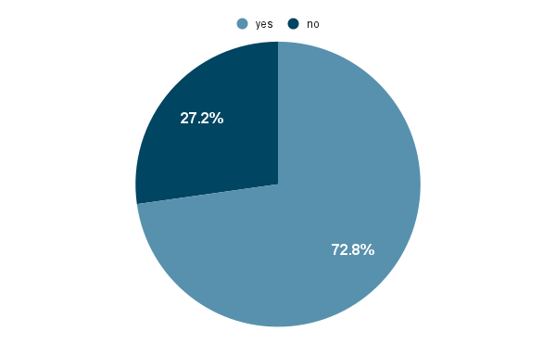
Hypothesis NO.5
(Cont.)

Slide 19
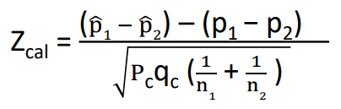

Hypothesis # 6
Testing extent of procrastination between those who play sports vs those who don’t?
We claimed that percentage of people that indulge in physical sports activities procrastinate same as those who don’t take part in physical sports .
P1 = Those who indulge in sports activities (Taking “OFTEN” as success)
P2 = Those who don’t indulge in sports activities (Taking “RARELY” as success)
n1 = Play sport often sample = 41
n2 = Play sport rarely sample = 42
p̂1 = corresponding ratio = $\frac{success 1}{sample 1}$ = $\frac{13}{41}$
p̂2 = corresponding ratio = $\frac{success 2}{sample 2}$ = $\frac{19}{42}$
P c = $\frac{x1+x2}{n1+n2}$ = $\frac{32}{83}$, q c = 1- Pc = $\frac{51}{83}$

Slide 20
Hypothesis # 6 (Cont.)
Testing the extent of Procrastination between those who play sports vs those who don’t.
H₀ : P 1 = P2
H₁ : P 1 < P2
α = 0.05 (significance level)
Z = 0.95 (confidence level)
Z_{cal} = -1.19 ( After calculation)
Z_{α} = 1.645 (one tailed)
Z_{cal} > Z_{α/2} (False)
Inference: The proportion of people who procrastinate often among those who play sports often is equal to the proportion of people who procrastinate often among those that play sports rarely.

Slide 21
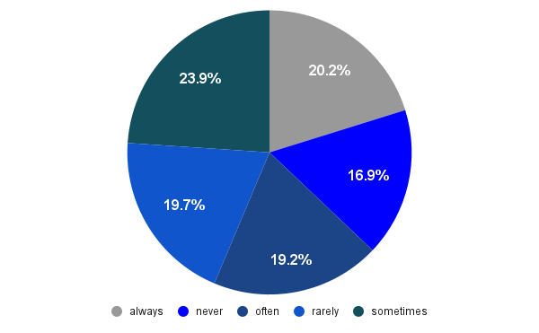
Hypothesis # 6 (Cont.)

Slide 22

Suggestions based on our statistical analysis
Clear Goal Setting:
Define specific objectives to provide a clear sense of purpose. Breaking down larger goals into manageable tasks enhances motivation and minimizes procrastination.
Structured Timetable:
Develop a well-planned timetable, prioritizing tasks based on urgency and importance. This structured approach reduces the overwhelming nature of a workload and instills a sense of order.

Slide 23
Suggestions based on our statistical analysis (Cont.)
Adherence to Schedule:
Commit to following the established timetable with the same diligence as professional appointments. Consistent adherence builds productive habits, mitigating tendencies toward procrastination.
Group Collaboration:
Harness the power of collaboration to create accountability and support. Working in groups fosters shared goals, encouragement, and a sense of responsibility, making tasks more engaging and reducing the temptation to procrastinate.

Slide 24

Thank You ☺

